Slide 1
Phase 0 Report
Group 006
Darcy, Gavin,Jacky, Jenny, Jerry, Lana

Slide 2
TABLE OF CONTENTS
01
02
03
04
05
06
Specification
CRC Model
Scenario Walkthrough
By Zi Hua
Gavin
By Lana
Skeleton Program and Unit Test
Now and Next
Solutions and Questions
By Darcy and Jacky
Each member’s current work and plans for the future
All
Things that we have done well and struggling with
Jenny

Slide 3
01
Specification
Zi Hua

Slide 4
Specification
Educational dictionary platform
Various services based on different demands
Student:
Learn English vocabulary
Individual learning
Collaborative learning
Teacher supervising
Customized tests
Teacher:
Gain students
Sell tests
Guest:
Dictionary

Slide 5
02
CRC Cards
Gavin

Slide 6
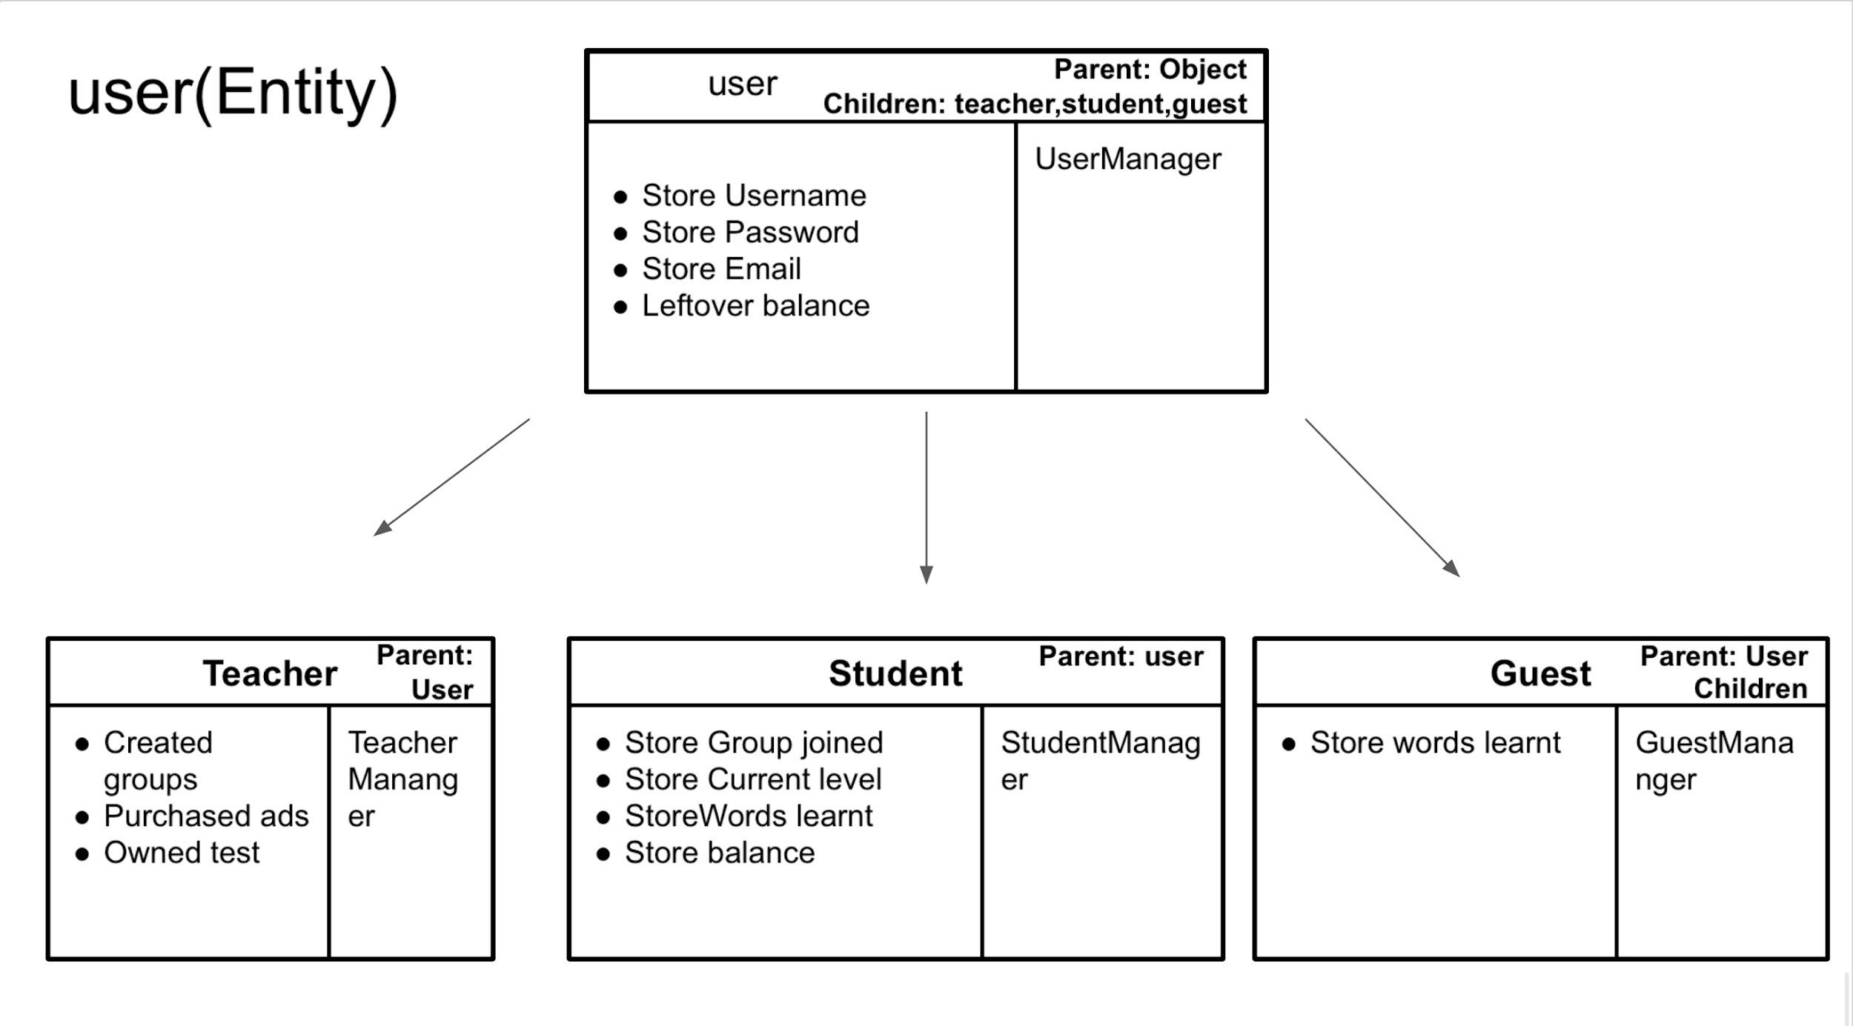
Entities
There are 11 entity classes in total but changes will be made along the way. Each entity class holds specific attributes for their designated purposes.
More entities will be added.
Some entities might be removed.

Slide 7
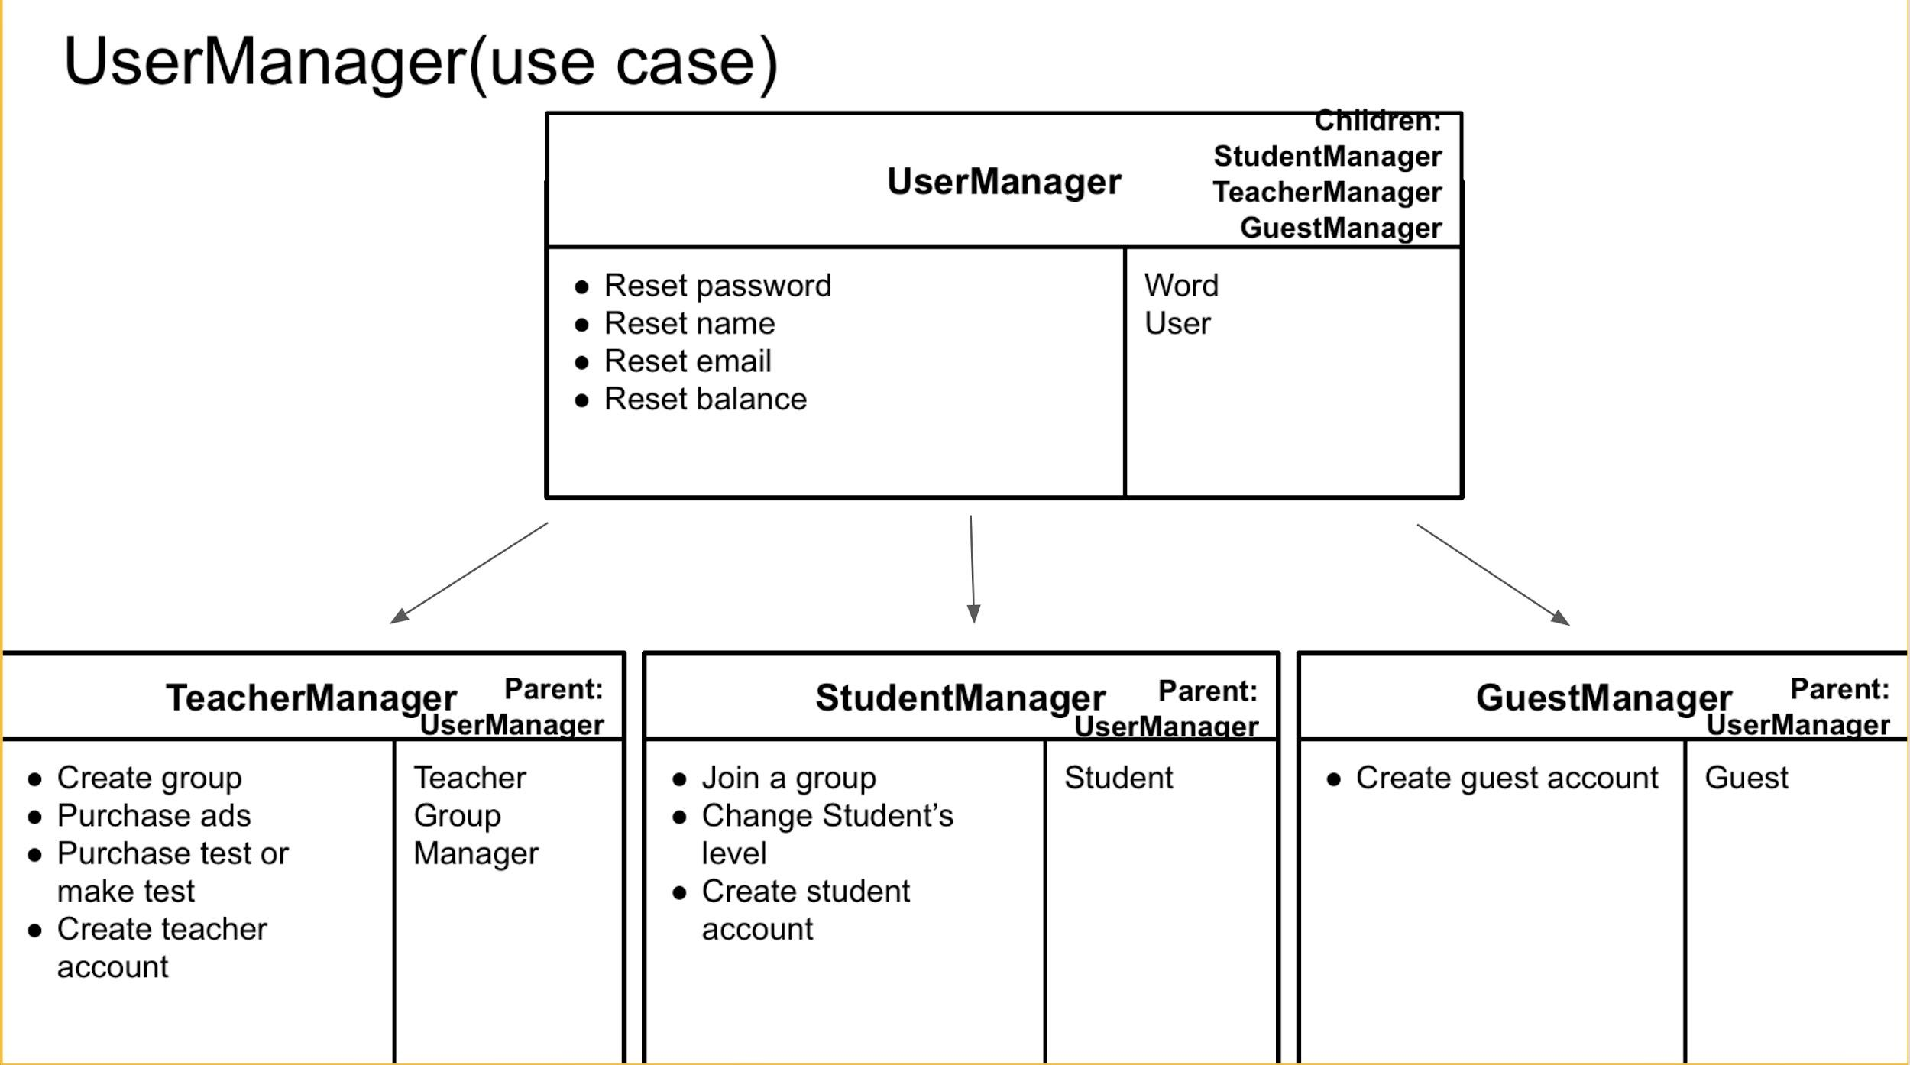
Use Case
There are currently 7 use case classes.
Most use case classes are directly associated with an entity class but there are also some use case classes designed only to imply certain rules.
More use cases will be added.

Slide 8
Controller and UI
Controller
UI
There are 2 controller classes that are used to interact with users. The classes MainController and FileManager deal with inputs from users. The MainController class takes input with the scanner method. The FileManager reads the user’s files and shows errors if the file is not readable.
The UI class is used to interact with users. For now, we are still using the terminal as our UI, but in the future, we plan to use GUI to interact with our users.

Slide 9
03
Scenario Walkthrough
Lana

Slide 10
Student User Scenario
Diagnostics
Asked to write a diagnostic quiz
Identification
Registration
Score and Level
Join Group
Identify if the user is a student, teacher or guest
Set username and password
Get a score and level for future use
Join existing groups
Notes:
This first scenario walk-through describes how the platform works for a new student to register and to log in for the first time. The student enters the system and is asked to choose if they are a student, teacher or guest. Then the student is asked to register their username and password which are stored in their profile once they confirm. When they log in to the account for the first time, they will be asked to do a diagnostic for measuring the level of knowledge for future uses. After that, the student can study individually or can join a group. If they join a group, they will be able to have access to the resources provided by the assigned teacher.

Slide 11
Teacher User Scenario
Registration
Set username and password
Identification
Create Tests
Identify if the user is a student, teacher or guest
Create a customized test
Notes:
Our second scenario walk-through describes the situation of how a teacher can use our platform. Similar to the student login steps, after the teacher logins to the system, they can create groups. Once a group is created, the teacher is allowed to upload tests and decide whether they want to mark them manually or automatically. The choice of the teacher determines if the score of each test is shown automatically or needed to be uploaded by the teacher.

Slide 12
04
Skeleton Program
Darcy and Jacky

Slide 13
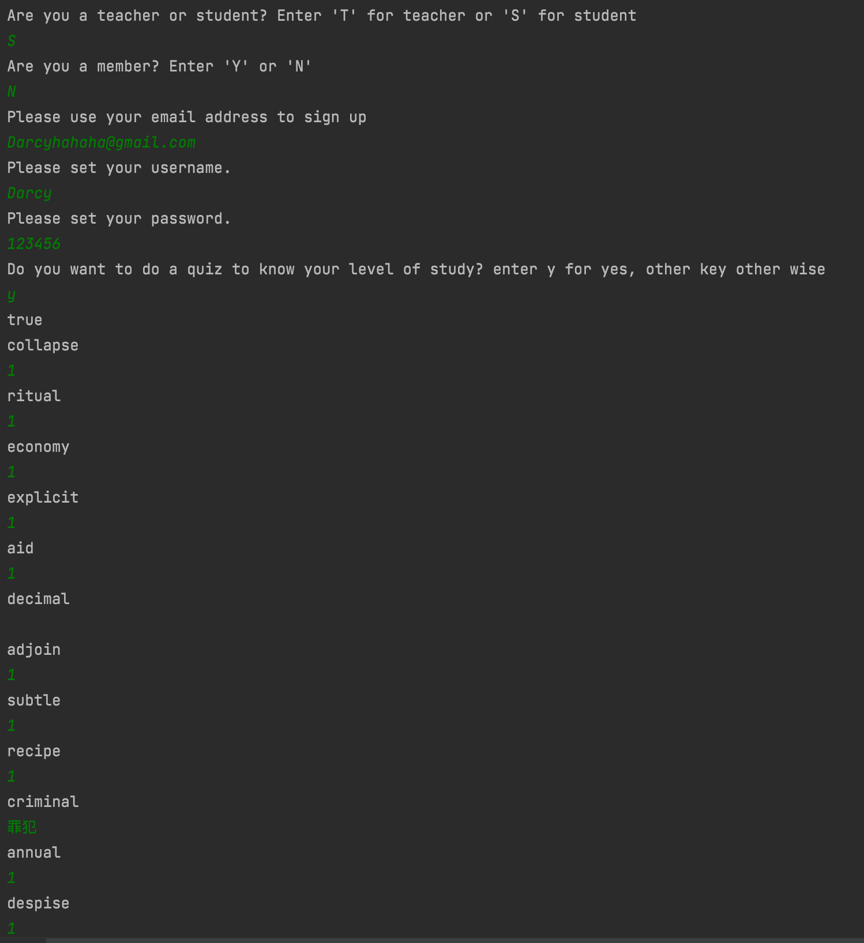
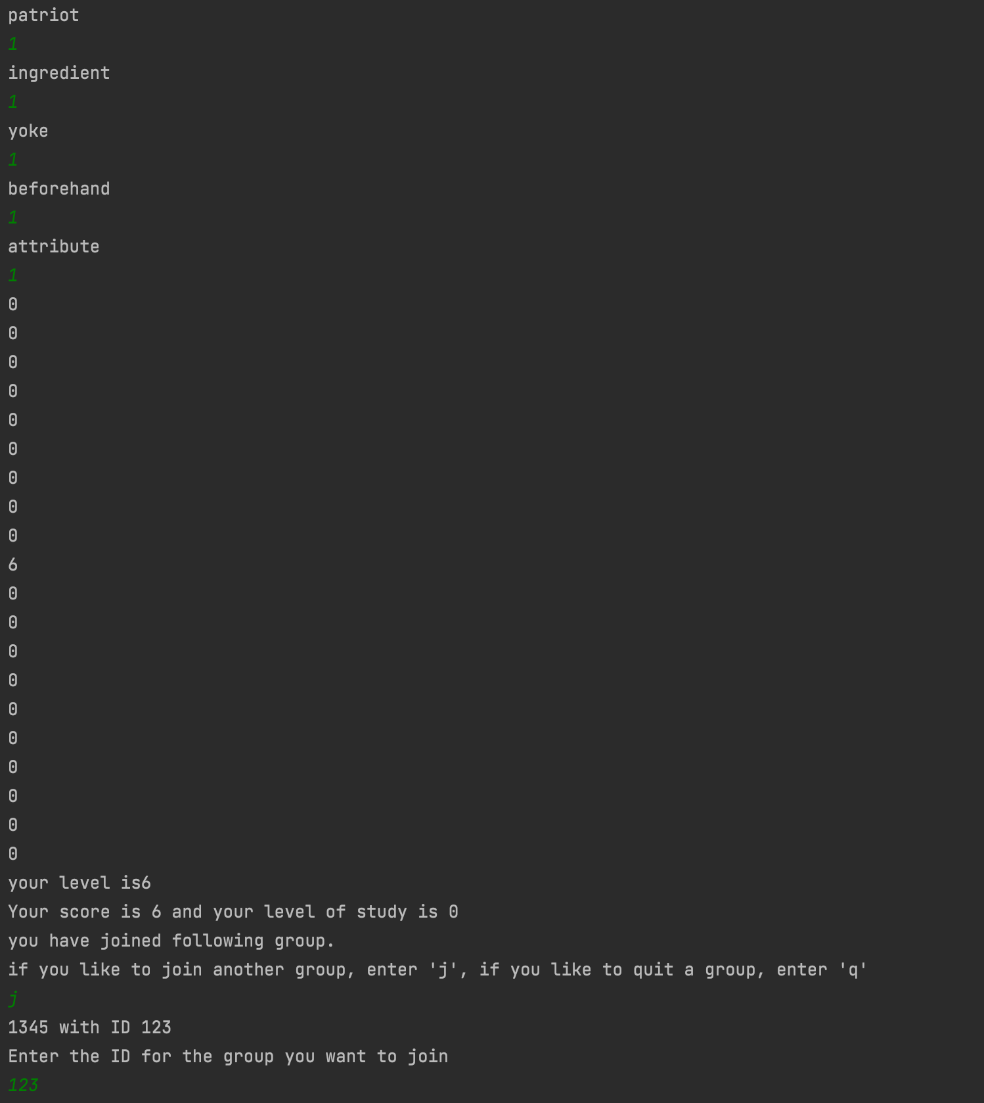
Skeleton Program (Student)

Slide 14
Skeleton Program (Student)
After regression, the student decide to do a diagnostic test
Any but one of the answers was contained in the correct answer, so the student scored a 6, and received a level of 0

Slide 15
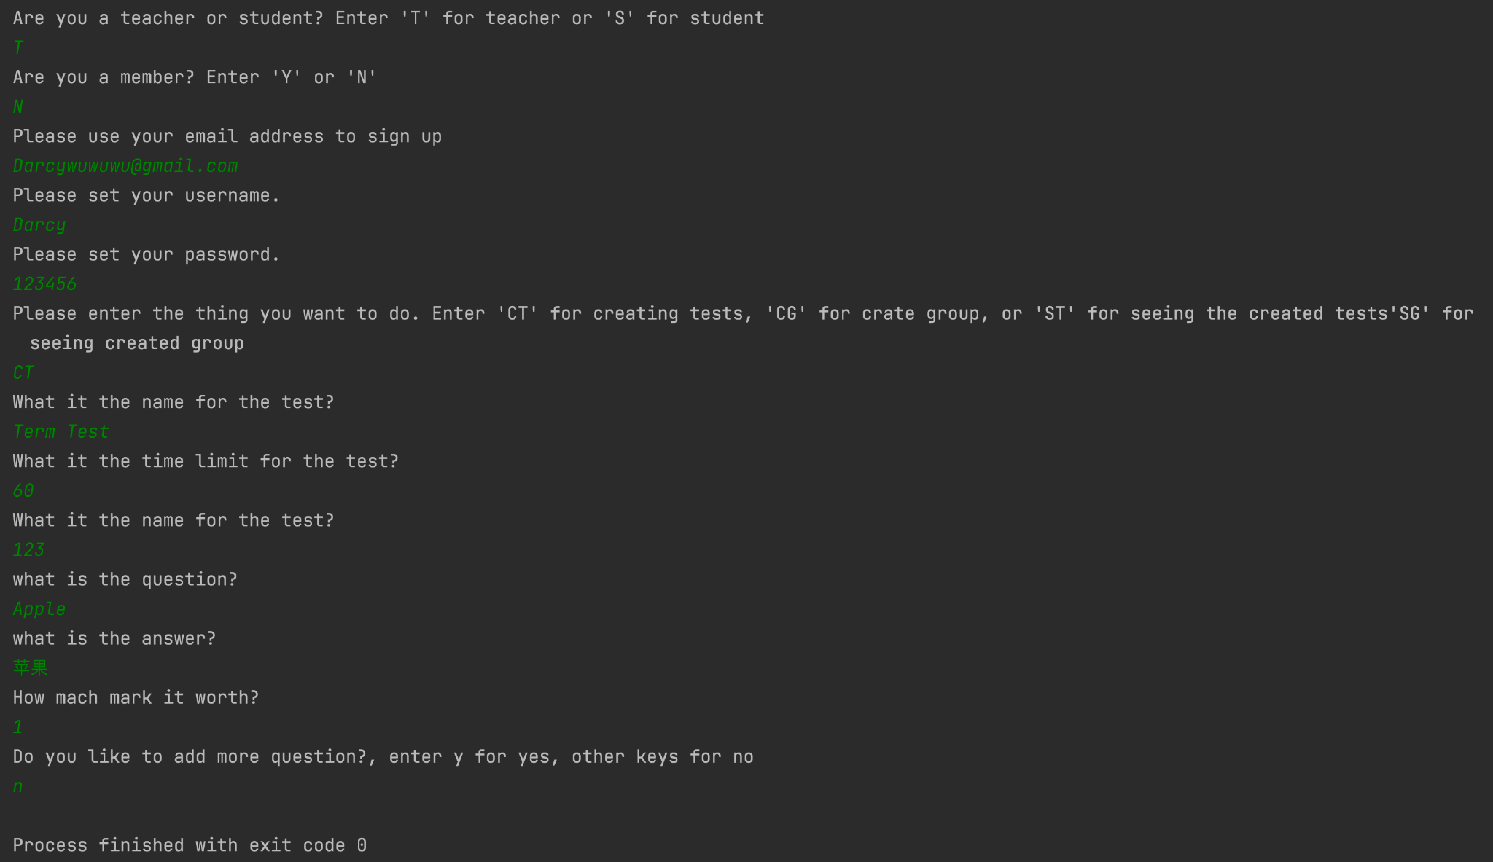
Skeleton Program
In this part, the teacher signed up for a account and created a test.

Slide 16
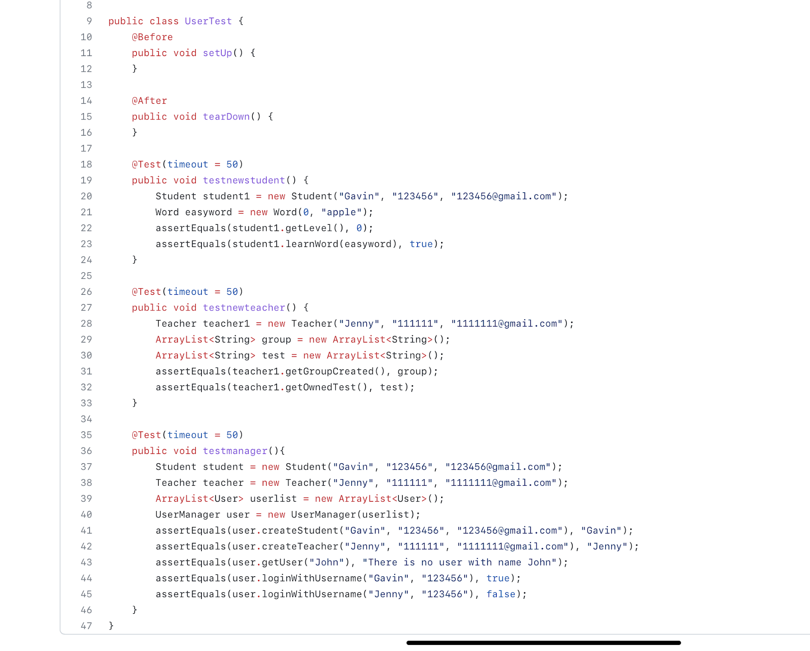
Unit Test
Making some unittest based on the scenario.
The UserTest checks if the students and teachers can create accounts and if they can login with their password. Also, it can check if it can record the process of the students learnt. (words learnt and words forgot)
The testTest checks if the teachers can create a test and add questions. And the students can take a diagnostic test. After they do the test, they can get the autograde.

Slide 17
05
Now and Future

Slide 18
Gavin Gao
Now
Next
Write code related to User, Teacher, Student and UserManager
Work for CRC card
Summarize User and its subclass
Implement Student and Teacher manager.
Learn about databases and store data
To be continued

Slide 19
Jacky Jiang
Now
Next
work together for crc model and specification
unittest
Make enough unittest
using the result of the unittest helps them to complete the classes.

Slide 20
Darcy Wang
Now
Next
Code for Test, Answer, Question and Test Manager.
Completion of main method.
Implement subclasses in question for different kinds of questions.
Introduce the trading of the test.

Slide 21
Jerry Xu
Now
Next
Code for group, group manager.
Write scenario work-through, specification and report.
Add more function to the group class such as the restriction of joining a group

Slide 22
Jenny Zhu
Now
Next
Word, Word Manager and File Manager
Report
Improve UI logic
Upgrade local txt to online database

Slide 23
Lana Zhang
Now
Next
Work for CRC card
Work on the class Main
Consider the Scenario Walk-Through and write code follow it
Continue to implement methods
Consider the suitable design pattern from the Design Question 1

Slide 24
06
Solutions and Questions
Jenny

Slide 25
Work Well Done
Design
Implement
Skeleton
Collaboration
Design well done after group discussion
All the codes are written according to design
Skeleton program perfectly perform scenario walkthrough
All group members work well together
Clean Architecture
Division of Labour
Learn from Others
Active discussion with TA
Correctly identify layers in clean architecture during design
Divide the group tasks to every member clearly
Actively discuss with our TA and ask questions
Proactively learn from other groups

Slide 26
Questions
How to accomplish real time update?
How to store constants without using static variables?
How to verify that our code follows SOLID and clean architecture?
How to implement membership system/ads that actually benefits teacher users?
How to store a general method that doesn’t belong to any object classes?

Slide 27

THANKS
Please keep this slide for attribution

Slide 28


